Slide 1
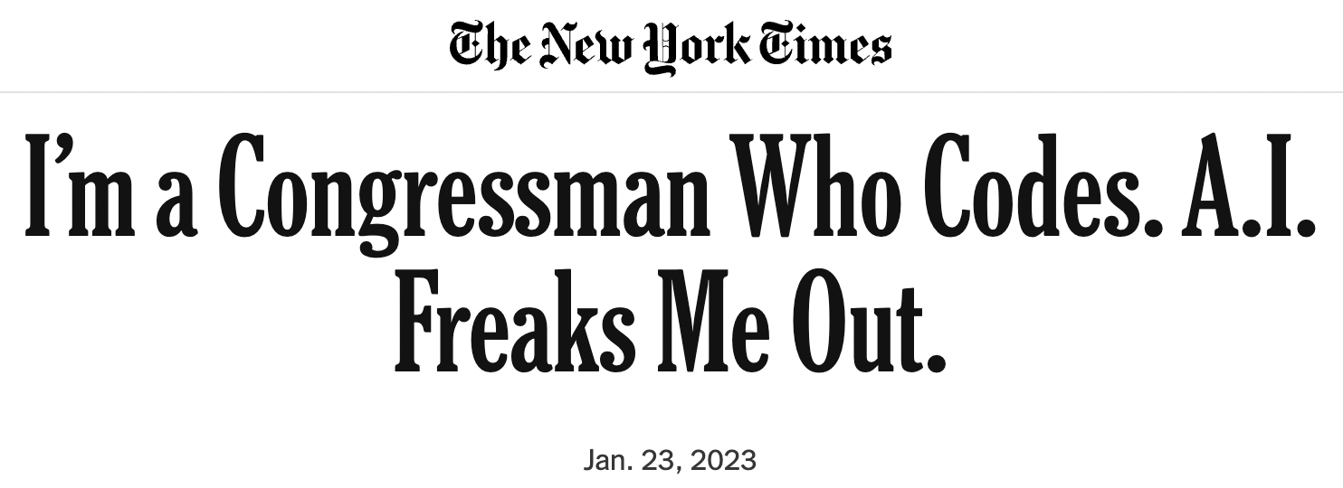


Slide 2


Slide 3
ChatGPT – calm down everyone
Q: which is bigger? an elephant or a cat?
A: An elephant is bigger than a cat.
Q: which is not bigger than the other? an elephant or a cat?
A: Neither an elephant nor a cat is bigger than the other.
Q: what is the largest even number?
A: The largest even number is 9,999,999,998.
Q: I started with 20 dollars and gave 10 dollars to my friend. How much do we have in total?
A: You and your friend have a total of 30 dollars.

Slide 4
Recap
A* expands the fringe node with lowest f value where
f(n) = g(n) + h(n)
g(n) is the cost to reach n
h(n) is an admissible estimate of the least cost from n to a goal node: 0 ≤ h(n) ≤ h*(n)
A* tree search is optimal
Its performance depends heavily on the heuristic h

Slide 5

Creating Heuristics

Slide 6
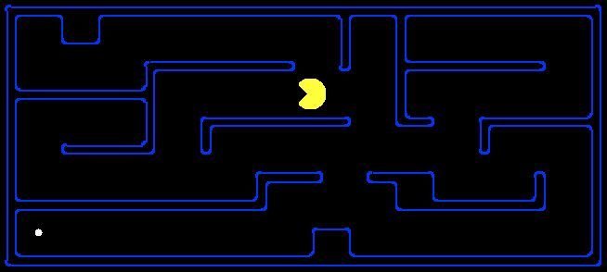
Creating Admissible Heuristics
Often, admissible heuristics are solutions to relaxed problems, where new actions are available
Problem P₂ is a relaxed version of P₁ if A₂(s) ⊇ A₁(s) for every s
Theorem: h₂*(s) ≤ h₁*(s) for every s, so h₂*(s) is admissible for P₁
15
366

Slide 7
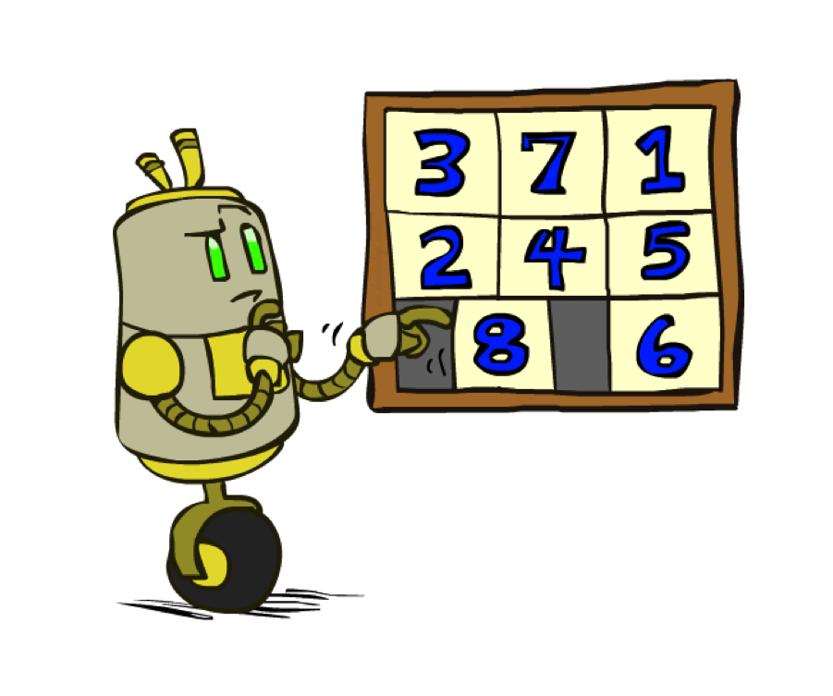
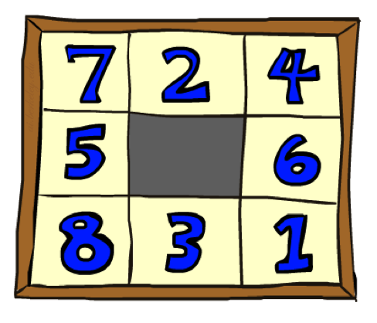
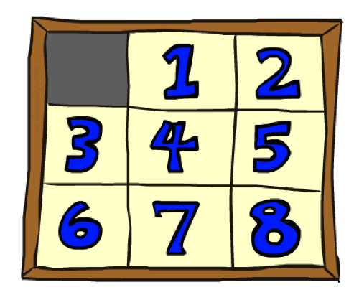
Example: 8 Puzzle
Start State
Actions
Goal State
What are the states?
How many states?
What are the actions?
What are the step costs?
Notes:
9! = 362,880 but 16! (15-puzzle) = 20 trillion, 25! = 10^25

Slide 8
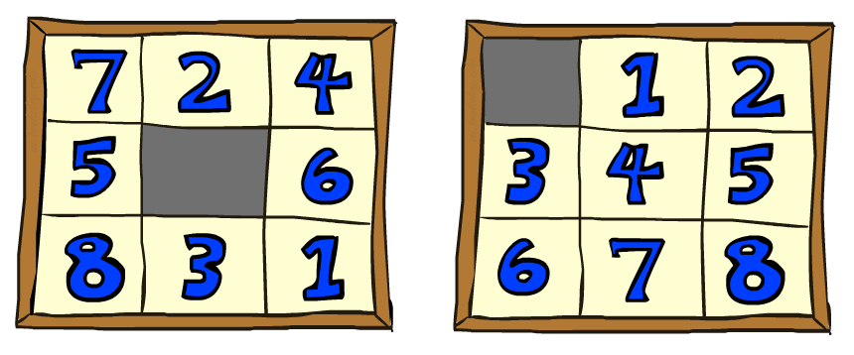

8 Puzzle I
Heuristic: Number of tiles misplaced
Why is it admissible?
h(start) =
8
Start State
Goal State
 | Average nodes expanded when the optimal path has…
 | …4 steps | …8 steps | …12 steps
UCS | 112 | 6,300 | 3.6 x 10⁶
A*TILES | 13 | 39 | 227
Statistics from Andrew Moore

Slide 9
8 Puzzle II
What if we had an easier 8-puzzle where any tile could slide any direction at any time, ignoring other tiles?
Total Manhattan distance
Why is it admissible?
h(start) =
Start State
Goal State
 | Average nodes expanded when the optimal path has…
 | …4 steps | …8 steps | …12 steps
A*TILES | 13 | 39 | 227
A*MANHATTAN | 12 | 25 | 73
3 + 1 + 2 + … = 18

Slide 10
Combining heuristics
Dominance: h₁ ≥ h₂ if
∀n h₁(n) ≥ h₂(n)
Roughly speaking, larger is better as long as both are admissible
The zero heuristic is pretty bad (what does A* do with h=0?)
The exact heuristic is pretty good, but usually too expensive!
What if we have two heuristics, neither dominates the other?
Form a new heuristic by taking the max of both:
h(n) = max( h₁(n), h₂(n))
Max of admissible heuristics is admissible and dominates both!
Notes:
Semi-lattice: x <= y <-> x = x ^ y

Slide 11

Example: Knight’s moves
Minimum number of knight’s moves to get from A to B?
h₁ = (Manhattan distance)/3
h₁’ = h₁ rounded up to correct parity (even if A, B same color, odd otherwise)
h₂ = (Euclidean distance)/√5 (rounded up to correct parity)
h₃ = (max x or y shift)/2 (rounded up to correct parity)
h(n) = max( h₁’(n), h₂(n), h₃(n)) is admissible!
Notes:
Semi-lattice: x <= y <-> x = x ^ y

Slide 12

Optimality of A* Graph Search
This part is a bit fiddly,
sorry about that

Slide 13
Quiz: State Space Graphs vs. Search Trees
Consider a rectangular grid:
How many states within d steps of start?
How many states in search tree of depth d?
Basic idea of graph search: don’t re-expand a state that has been expanded previously

Slide 14
A* Graph Search Gone Wrong?
State space graph
Search tree
h=4
A
S (0+2)
1
h=1
S
1
C
A (1+4)
B (1+1)
h=2
1
2
B
3
C (2+1)
C (3+1)
h=1
G
G (5+0)
G (6+0)
Simple check against expanded set blocks C
h=0
Fancy check allows new C if cheaper than old
but requires recalculating C’s descendants

Slide 15
Consistency of Heuristics
Main idea: estimated heuristic costs ≤ actual costs
Admissibility: heuristic cost ≤ actual cost to goal
h(A) ≤ h*(A)
Consistency: heuristic “arc” cost ≤ actual cost for each arc
h(A) – h(C) ≤ c(A,C)
or h(A) ≤ c(A,C) + h(C) (triangle inequality)
Note: h* necessarily satisfies triangle inequality
Consequences of consistency:
The f value along a path never decreases:
h(A) ≤ c(A,C) + h(C) => g(A) + h(A) ≤ g(A) + c(A,C) + h(C)
A* graph search is optimal
A
1
C
h=4
h=1
h=3
G

Slide 16
Optimality of A* Graph Search
Sketch: consider what A* does with a consistent heuristic:
Fact 1: In tree search, A* expands nodes in increasing total f value (f-contours)
Fact 2: For every state s, nodes that reach s optimally are expanded before nodes that reach s suboptimally
Result: A* graph search is optimal
…
f ≤ 1
f ≤ 2
f ≤ 3

Slide 17
Optimality
Tree search:
A* is optimal if heuristic is admissible
Graph search:
A* optimal if heuristic is consistent
Consistency implies admissibility
Most natural admissible heuristics tend to be consistent, especially if from relaxed problems

Slide 18

But…
A* keeps the entire explored region in memory
=> will run out of space before you get bored waiting for the answer
There are variants that use less memory (Section 3.5.5):
IDA* works like iterative deepening, except it uses an f-limit instead of a depth limit
On each iteration, remember the smallest f-value that exceeds the current limit, use as new limit
Very inefficient when f is real-valued and each node has a unique value
RBFS is a recursive depth-first search that uses an f-limit = the f-value of the best alternative path available from any ancestor of the current node
When the limit is exceeded, the recursion unwinds but remembers the best reachable f-value on that branch
SMA* uses all available memory for the queue, minimizing thrashing
When full, drop worst node on the queue but remember its value in the parent

Slide 19

A*: Summary
A* orders nodes in the queue by f(n) = g(n) + h(n)
A* is optimal for trees/graphs with admissible/consistent heuristics
Heuristic design is key: often use relaxed problems
g
g
h
h

Slide 20

CS 188: Artificial Intelligence
Local search
Instructors: Stuart Russell and Peyrin Kao
University of California, Berkeley

Slide 21
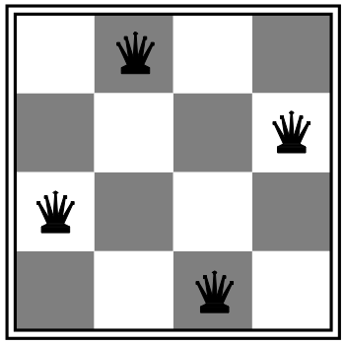
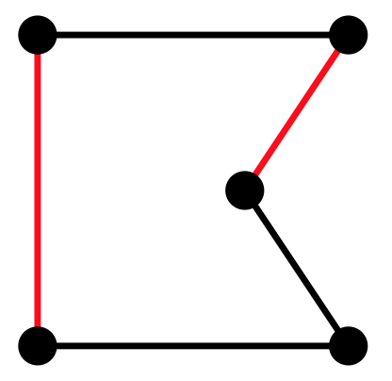
Local search algorithms
In many optimization problems, path is irrelevant; the goal state is the solution
Then state space = set of “complete” configurations; find configuration satisfying constraints, e.g., n-queens problem; or, find optimal configuration, e.g., travelling salesperson problem
In such cases, can use iterative improvement algorithms: keep a single “current” state, try to improve it
Constant space, suitable for online as well as offline search
More or less unavoidable if the “state” is yourself (i.e., learning)

Slide 22
Hill Climbing
Simple, general idea:
Start wherever
Repeat: move to the best neighboring state
If no neighbors better than current, quit

Slide 23
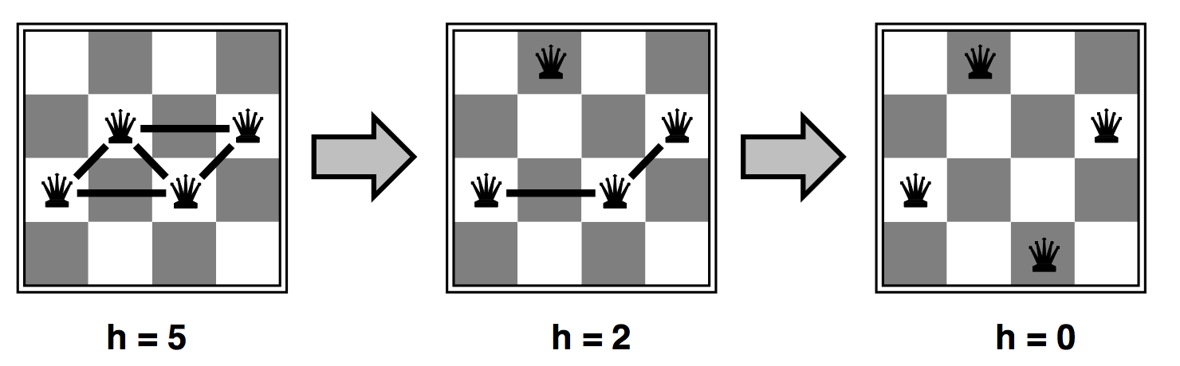
Heuristic for n-queens problem
Goal: n queens on board with no conflicts, i.e., no queen attacking another
States: n queens on board, one per column
Actions: move a queen in its column
Heuristic value function: number of conflicts

Slide 24
Hill-climbing algorithm
function HILL-CLIMBING(problem) returns a state
current ← make-node(problem.initial-state)
loop do
neighbor ← a highest-valued successor of current
if neighbor.value ≤ current.value then
return current.state
current ← neighbor
“Like climbing Everest in thick fog with amnesia”

Slide 25
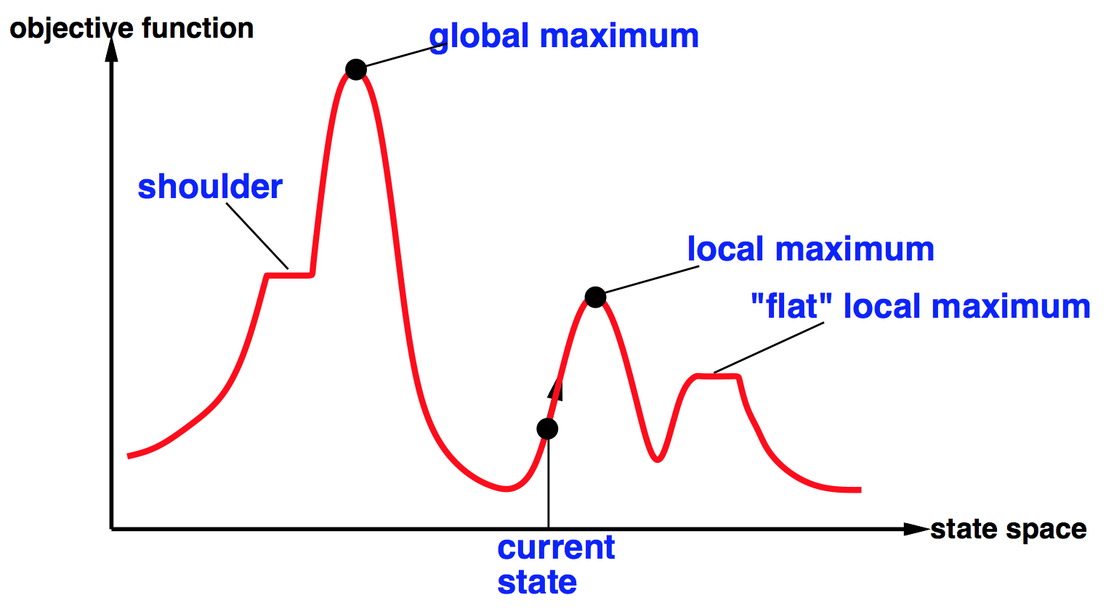

Global and local maxima
Random restarts
find global optimum
duh
Random sideways moves
Escape from shoulders
Loop forever on flat local maxima

Slide 26
Hill-climbing on the 8-queens problem
No sideways moves:
Succeeds w/ prob. 0.14
Average number of moves per trial:
4 when succeeding, 3 when getting stuck
Expected total number of moves needed:
3(1-p)/p + 4 =~ 22 moves
Allowing 100 sideways moves:
Succeeds w/ prob. 0.94
Average number of moves per trial:
21 when succeeding, 65 when getting stuck
Expected total number of moves needed:
65(1-p)/p + 21 =~ 25 moves
Moral: algorithms with knobs
to twiddle are irritating

Slide 27
Simulated annealing
Resembles the annealing process used to cool metals slowly to reach an ordered (low-energy) state
Basic idea:
Allow “bad” moves occasionally, depending on “temperature”
High temperature => more bad moves allowed, shake the system out of its local minimum
Gradually reduce temperature according to some schedule
Sounds pretty flaky, doesn’t it?

Slide 28

Simulated annealing algorithm
function SIMULATED-ANNEALING(problem,schedule) returns a state
current ← problem.initial-state
for t = 1 to ∞ do
T ←schedule(t) if T = 0 then return current next ← a randomly selected successor of current
∆E ← next.value – current.value if ∆E > 0 then current ← next else current ← next only with probability e^{∆E/T}

Slide 29
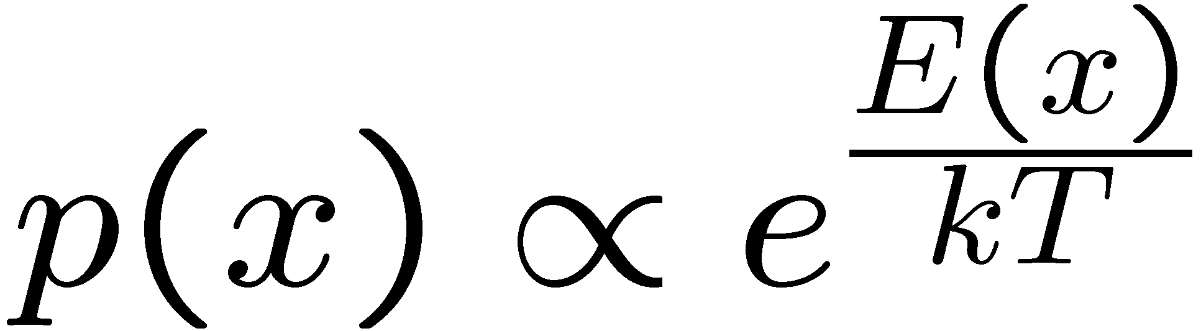
Simulated Annealing
Theoretical guarantee:
Stationary distribution (Boltzmann): P(x) α e^{E(x)/T}
If T decreased slowly enough, will converge to optimal state!
Proof sketch
Consider two adjacent states x, y with E(y) > E(x) [high is good]
Assume x→y and y→x and outdegrees D(x) = D(y) = D
Let P(x), P(y) be the equilibrium occupancy probabilities at T
Let P(x→y) be the probability that state x transitions to state y
x
y
Notes:
P(x)P(x->y) = P(y)P(y->x)
P(x)/D = P(y)exp((E(x)-E(y))/T)/D
P(x)/P(y) = exp(E(x)/T) / exp(E(y)/T)

Slide 30
Occupation probability as a function of T
E(x)
x

Slide 31
Simulated Annealing
Is this convergence an interesting guarantee?
Sounds like magic, but reality is reality:
The more downhill steps you need to escape a local optimum, the less likely you are to ever make them all in a row
“Slowly enough” may mean exponentially slowly
Random restart hillclimbing also converges to optimal state…
Simulated annealing and its relatives are a key workhorse in VLSI layout and other optimal configuration problems

Slide 32
Local beam search
Basic idea:
K copies of a local search algorithm, initialized randomly
For each iteration
Generate ALL successors from K current states
Choose best K of these to be the new current states
Or, K chosen randomly with
a bias towards good ones

Slide 33
Beam search example (K=4)
X
7
X
7
8
9
10
9
X
8
9
9
8
9
10
9
10
8
10
7
9
9
X
6
X
5
X
7
X
3
6
8
9
X
7
9

Slide 34
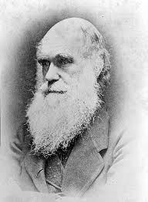
Local beam search
Why is this different from K local searches in parallel?
The searches communicate! “Come over here, the grass is greener!”
What other well-known algorithm does this remind you of?
Evolution!

Slide 35

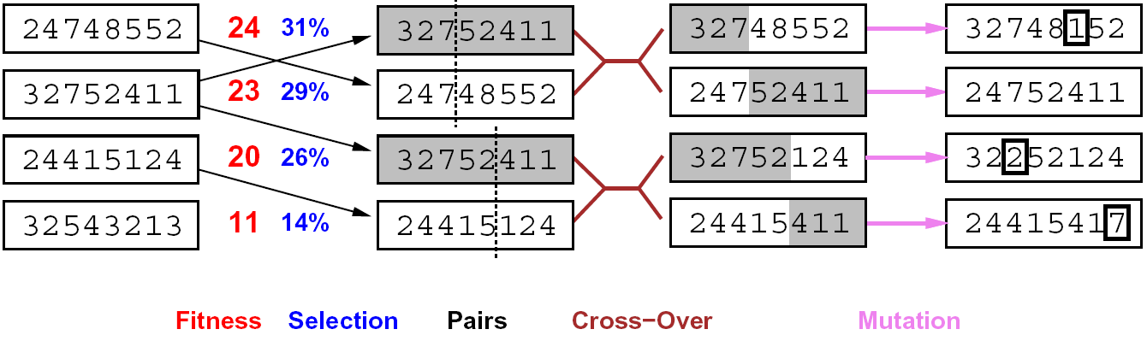
Genetic algorithms
Genetic algorithms use a natural selection metaphor
Resample K individuals at each step (selection) weighted by fitness function
Combine by pairwise crossover operators, plus mutation to give variety

Slide 36
Example: N-Queens
Does crossover make sense here?
What would mutation be?
What would a good fitness function be?

Slide 37

Local search in continuous spaces

Slide 38
Example: Siting airports in Romania
Place 3 airports to minimize the sum of squared distances from each city to its nearest airport
Airport locations
x = (x₁,y₁), (x₂,y₂), (x₃,y₃)
City locations (x_{c},y_{c})
C_{a} = cities closest to airport a
Objective: minimize
f(x) = Σ_{a} Σ_{c∈Ca} (x_{a} - x_{c})² + (y_{a} - y_{c})²

Slide 39
Handling a continuous state/action space
Discretize it!
Define a grid with increment δ , use any of the discrete algorithms
Choose random perturbations to the state
First-choice hill-climbing: keep trying until something improves the state
Simulated annealing
Compute gradient of f(x) analytically

Slide 40
Finding extrema in continuous space
Gradient vector ∇f(x) = (∂f/∂x₁, ∂f/∂y₁, ∂f/∂x₂, …)^{T}
For the airports, f(x) = Σ_{a} Σ_{c∈Ca} (x_{a} - x_{c})² + (y_{a} - y_{c})²
∂f/∂x₁ = Σ_{c∈C1} 2(x₁ - x_{c})
At an extremum, ∇f(x) = 0
Can sometimes solve in closed form: x₁ = (Σ_{c∈C1} x_{c})/|C₁|
Is this a local or global minimum of f?
Gradient descent: x ← x - α∇f(x)
Huge range of algorithms for finding extrema using gradients

Slide 41
Summary
Many configuration and optimization problems can be formulated as local search
General families of algorithms:
Hill-climbing, continuous optimization
Simulated annealing (and other stochastic methods)
Local beam search: multiple interaction searches
Genetic algorithms: break and recombine states
Many machine learning algorithms are local searches

